Slide 1
Unit -2

Slide 2
Short history of cryptography
Fundamental study of cryptography
An original message is known as the plaintext,
while the coded message is called the ciphertext.
The process of converting from plaintext to ciphertext is known as enciphering or encryption
;restoring the plaintext from the ciphertext is deciphering or decryption.
The many schemes used for encryption constitute the area of study known as cryptography. Such a scheme is known as a cryptographic system or a cipher

Slide 3
Techniques used for deciphering a message without any knowledge of the enciphering details fall into the area of cryptanalysis
.Cryptanalysis is what the layperson calls “breaking the code.”
The areas of cryptography and cryptanalysis together are called cryptology.

Slide 4
Symmetric encryption is a form of cryptosystem in which encryption and decryption are performed using the same key.It is also known as conventional encryption.
Symmetric encryption transforms plaintext into ciphertext using a secret key and an encryption algorithm. Using the same key and a decryption algorithm, the plaintext is recovered from the ciphertext.
The two types of attack on an encryption algorithm are cryptanalysis, based on properties of the encryption algorithm, and brute-force, which involves trying all possible keys.

Slide 5
Steganography is a technique for hiding a secret message within a larger one in such a way that others cannot discern the presence or contents of the hidden message.

Slide 6
Block Cipher principles
A block cipher is an encryption/decryption scheme in which a block of
plaintext is treated as a whole and used to produce a ciphertext block of
equal length.
Many block ciphers have a Feistel structure. Such a structure consists of a
number of identical rounds of processing. In each round, a substitution is
performed on one half of the data being processed, followed by a permu-
tation that interchanges the two halves. The original key is expanded so
that a different key is used for each round.

Slide 7
A stream cipher is one that encrypts a digital data stream one bit or one byte at a time. Examples of classical stream ciphers are the auto keyed Vigenère cipher and the Vernam cipher.
A block cipher is one in which a block of plaintext is treated as a whole and used to produce a cipher text block of equal length. Typically, a block size of 64 or 128 bits is used. As with a stream cipher, the two users share a symmetric encryption key.
A block cipher operates on a plaintext block of n bits to produce a cipher text block of n bits. There are 2 power n possible different plaintext blocks and, for the encryption to be reversible (i.e., for decryption to be possible), each must produce a unique cipher text block.

Slide 8
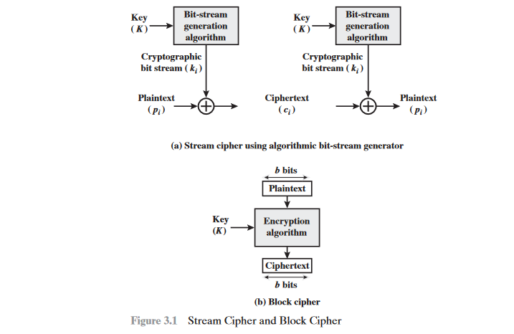

Slide 9
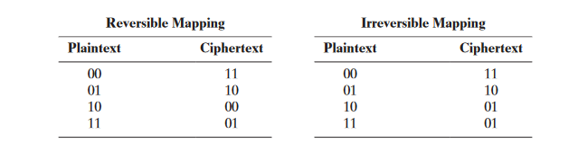
Such a transformation is called reversible, or nonsingular. The following examples illustrate nonsingular and singular transfor-mations for n=2.
The Feistel Cipher
Feistel proposed [FEIS73] that we can approximate the ideal block cipher by utilizing the concept of a product cipher, which is the execution of two or more simple ciphers in sequence in such a way that the final result or product is cryptographically stronger than any of the component ciphers.

Slide 10
In particular, Feistel proposed the use of a cipher that alternates substitutions and permutations, where these terms are defined as follows:
• Substitution: Each plaintext element or group of elements is uniquely replaced by a corresponding cipher text element or group of elements.
• Permutation: A sequence of plaintext elements is replaced by a permutation of that sequence. That is, no elements are added or deleted or replaced in the sequence, rather the order in which the elements appear in the sequence is changed

Slide 11
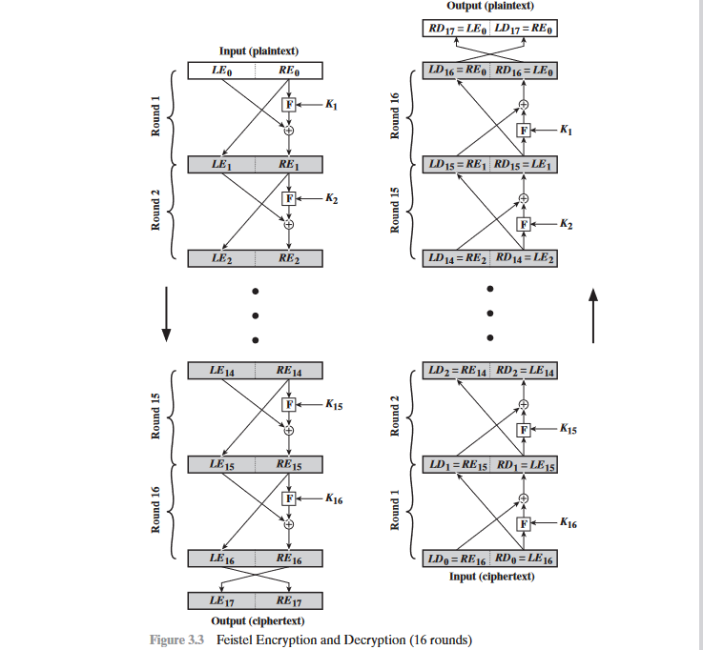

Slide 12
The exact realization of a Feistel network depends on the choice of the following parameters and design features:
Block size
Key size
Number of rounds
Subkey generation algorithm
Round function F

Slide 13
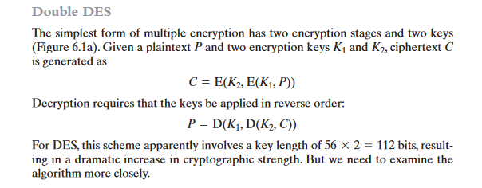
Black cipher operation
Multiple encryption is a technique in which an encryption algorithm is used multiple times. In the first instance, plaintext is converted to cipher text using the encryption algorithm. This cipher text is then used as input and the algorithm is applied again. This process may be repeated through any number of stages

Slide 14
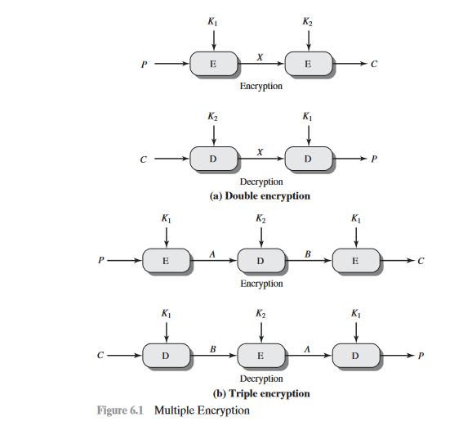

Slide 15
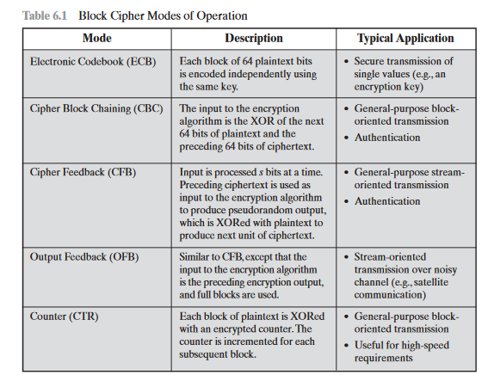

Slide 16
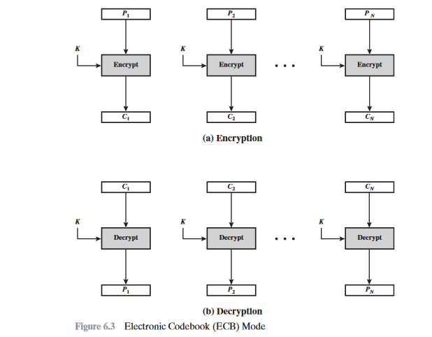

Slide 17
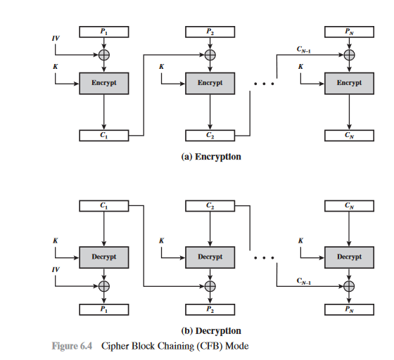

Slide 18
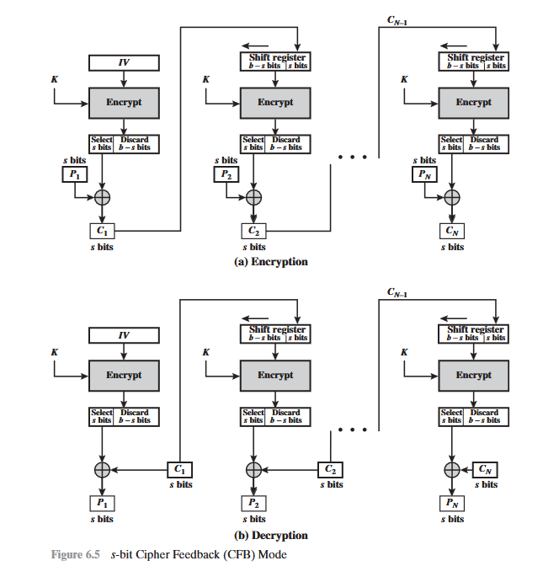

Slide 19
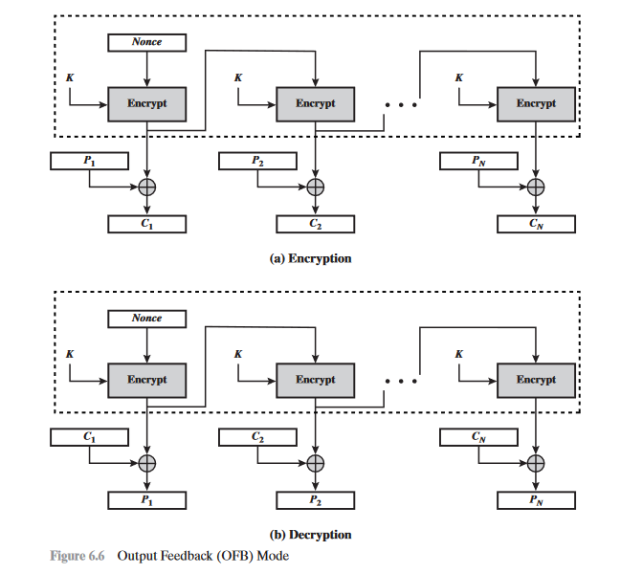

Slide 20
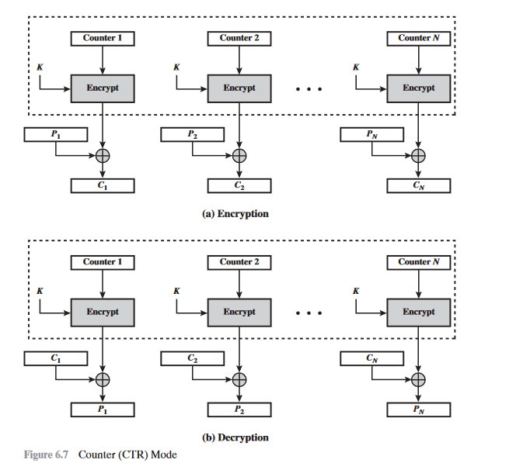

Slide 21
stream cipher
A typical stream cipher encrypts plaintext one byte at a time, although a stream cipher may be designed to operate on one bit at a time or on units larger than a byte at a time.
in this structure, a key is input to a pseudorandom bit generator that produces a stream of 8-bit numbers that are apparently random. The output of the generator, called a key stream, is combined one byte at a time with the plaintext stream using the bit-wise exclusive-OR (XOR) operation.

Slide 22
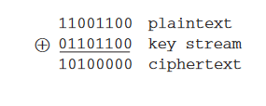
For example, if the next byte generated by the generator is 01101100 and the next plaintext byte is 11001100, then the resulting ciphertext byte is

Slide 23
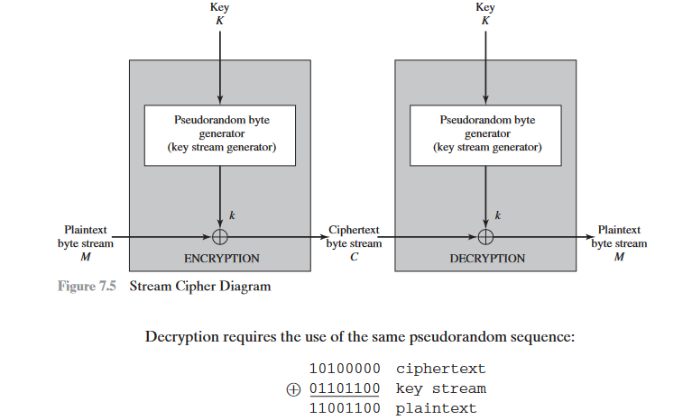

Slide 24
lists the following important design considerations for a stream cipher
1.The encryption sequence should have a large period. A pseudorandom num-ber generator uses a function that produces a deterministic stream of bits that eventually repeats.
2.the keystream should approximate the properties of a true random number stream as close as possible
3.the output of the pseudorandom number generator is conditioned on the value of the input key. To guard against brute-force attacks, the key needs to be sufficiently long.

Slide 25
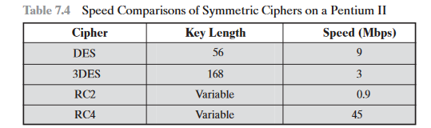

Slide 26
SYMMETRIC CIPHER MODEL
A symmetric encryption scheme has five ingredients
Plaintext: This is the original intelligible message or data that is fed into the algorithm as input.
• Encryption algorithm: The encryption algorithm performs various substitutions and transformations on the plaintext.
• Secret key: The secret key is also input to the encryption algorithm
The key is a value independent of the plaintext and of the algorithm

Slide 27
Ciphertext: This is the scrambled message produced as output. It depends on the plaintext and the secret key. For a given message, two different keys will produce two different ciphertexts.
Decryption algorithm: This is essentially the encryption algorithm run in reverse. It takes the ciphertext and the secret key and produces the original plaintext.
There are two requirements for secure use of conventional encryption:
1. We need a strong encryption algorithm
2.Sender and receiver must have obtained copies of the secret key in a secure fashion and must keep the key secure

Slide 28
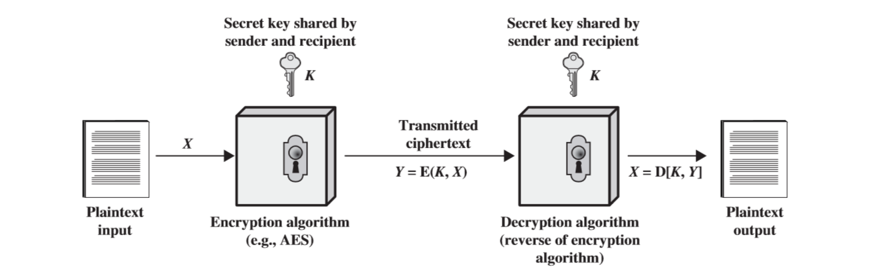
Simplified Model of Symmetric Encryption

Slide 29
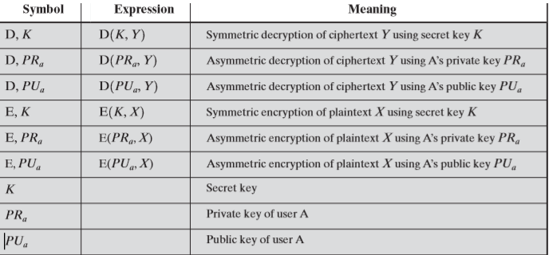

Slide 30
Cryptographic systems are characterized along three independent dimensions:
1.The type of operations used for transforming plaintext to ciphertext
All encryption algorithms are based on two general principles: substitution, in which each element in the plaintext (bit, letter, group of bits or letters) is mapped into another element, and transposition, in which elements in the plaintext are rearranged.

Slide 31
2 The number of keys used. If both sender and receiver use the same key, the system is referred to as symmetric, single-key,secret-key,or conventional encryption. If the sender and receiver use different keys, the system is referred to as asymmetric,two-key,or public-key encryption.
3. The way in which the plaintext is processed. A block cipher processes the input one block of elements at a time, producing an output block for each input block. A stream cipher processes the input elements continuously, producing output one element at a time,as it goes along.

Slide 32
THE DATA ENCRYPTION STANDARD(DES)
The most widely used encryption scheme is based on the Data Encryption Standard
(DES) adopted in 1977 by the National Bureau of Standards, now the National Institute of Standards and Technology (NIST), as Federal Information Processing Standard 46 (FIPS PUB 46).
The algorithm itself is referred to as the Data Encryption Algorithm (DEA).For DES, data are encrypted in 64-bit blocks using a 56-bit key. The algorithm transforms 64-bit input in a series of steps into a 64-bit output.The same steps, with the same key, are used to reverse the encryption.

Slide 33
Figure 3.5. As with any encryption scheme, there are two inputs to the encryption function: the plaintext to be encrypted and the key. In this case, the plaintext must be 64 bits in length and the key is 56 bits in length.
Looking at the left-hand side of the figure, we can see that the processing of the plaintext proceeds in three phases. First, the 64-bit plaintext passes through an initial permutation (IP) that rearranges the bits to produce the permuted input.

Slide 34
This is followed by a phase consisting of sixteen rounds of the same function,which involves both permutation and substitution functions.
The output of the last (sixteenth) round consists of 64 bits that are a function of the input plaintext and the key. The left and right halves of the output are swapped to produce the preoutput.
Finally, the preoutput is passed through a permutation that is the inverse of the initial permutation function, to produce the 64-bit ciphertext.With the exception of the initial and final permutations, DES has the exact structure of a Feistel cipher.

Slide 35
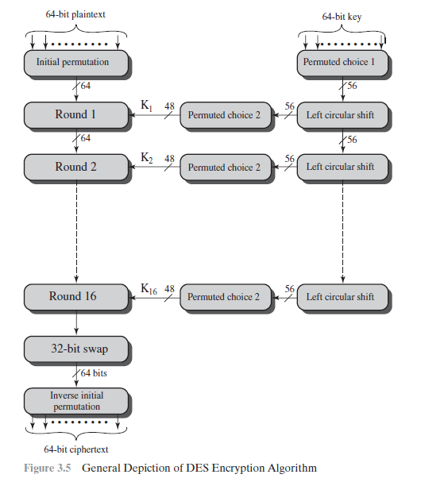

Slide 36
INITIAL PERMUTATION The initial permutation and its inverse are defined by tables ,as shown in Tables 3.2a and 3.2b, respectively. The tables are to be interpreted as follows.
The input to a table consists of 64 bits numbered from 1 to 64.The 64 entries in the permutation table contain a permutation of the numbers from 1 to 64.

Slide 37
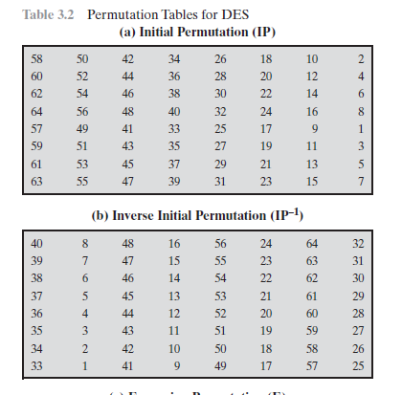

Slide 38
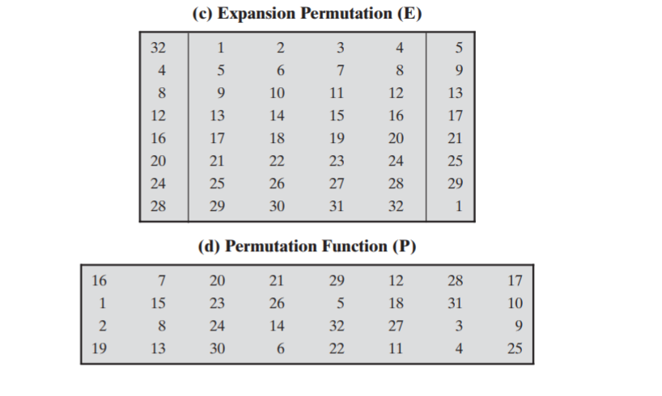

Slide 39
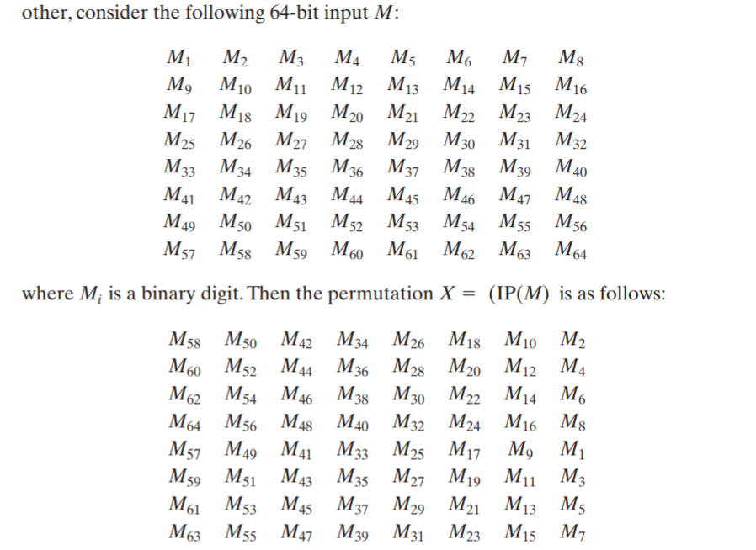

Slide 40
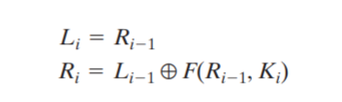
DETAILS OF SINGLE ROUND

Slide 41
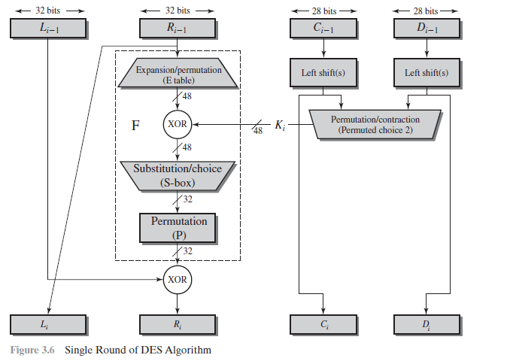

Slide 42
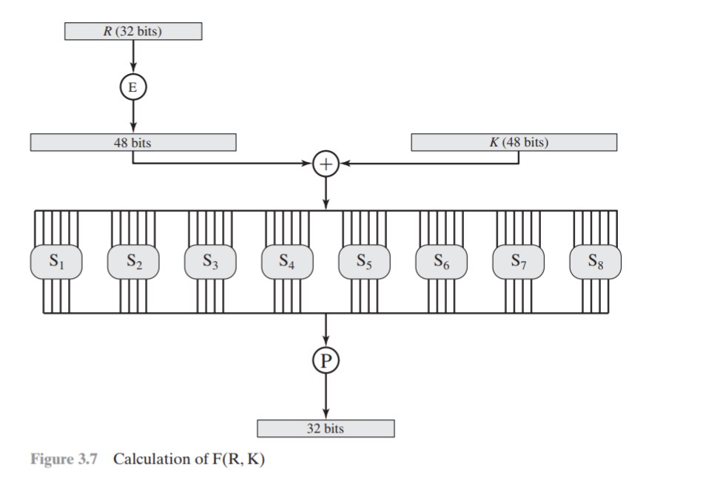

Slide 43
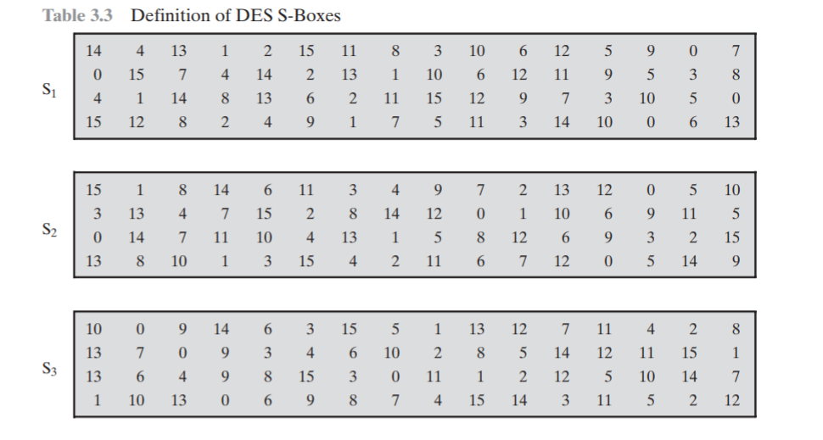

Slide 44
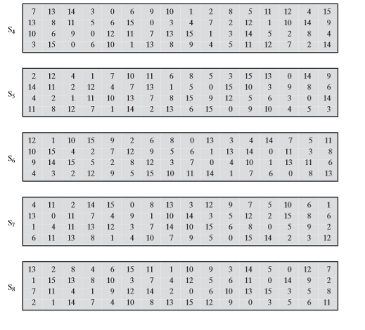

Slide 45
The first and last bits of the input to box form a 2-bit binary number to select one of four substitutions defined by the four rows in the table for .
The middle four bits select one of the sixteen columns.
The decimal value in the cell selected by the row and column is then converted to its 4-bit representation to produce the output.
For example, in S1, for input 011001, the row is 01 (row 1) and the column is 1100 (column 12).The value in row 1, column 12 is 9, so the output is 1001.

Slide 46
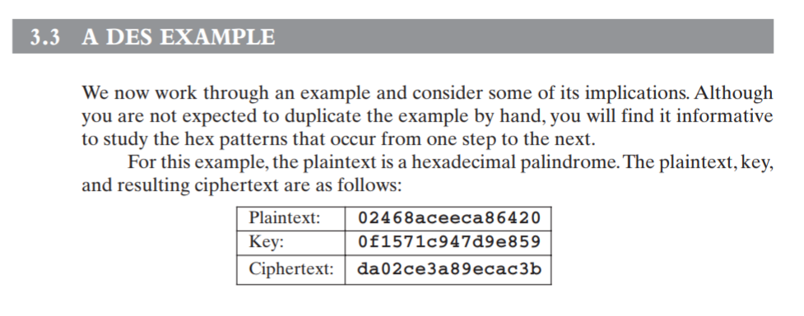

Slide 47
Advanced Encryption Standard (AES)
AES is a block cipher intended to replace DES for commercial applications. It uses a 128-bit block size and a key size of 128, 192, or 256 bits.
AES does not use a Feistel structure. Instead, each full round consists of four separate functions: byte substitution, permutation, arithmetic opera- tions over a finite field, and XOR with a key.
The cipher takes a plaintext block size of 128 bits, or 16 bytes. The key length can be 16(10 rounds), 24(12 rounds), or 32(14 rounds) bytes (128, 192, or 256 bits). The algorithm is referred to as AES-128, AES-192, or AES-256, depending on the key length.

Slide 48
Overview of AES
Block size -128 bit plain text(4word/16 bytes):1 word =32 bits
NO.of rounds:10
Key size:128 bit(4word/16 bytes)
No.of subkeys-44 sub keys
Each subkey size-32 bits(1 word/4 bytes)
Each round using-4 sub keys(4 words/16 bytes/128 bits)
Pre round condition-4 sub key
Cipher text-128 bits(4 words/16 bytes)

Slide 49
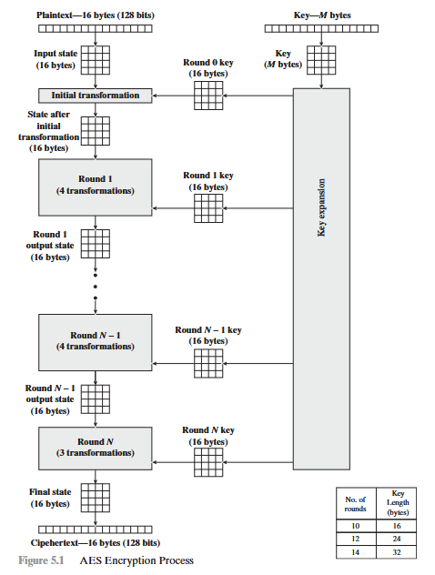

Slide 50
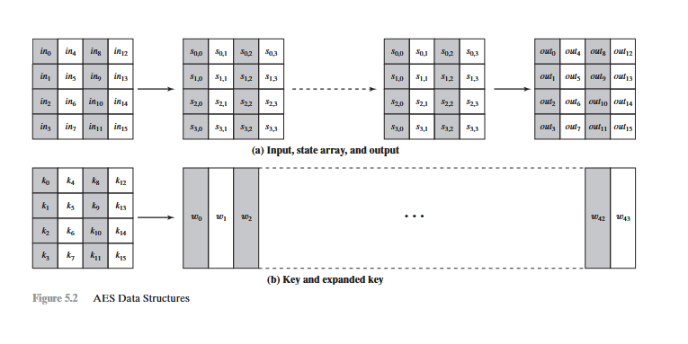

Slide 51
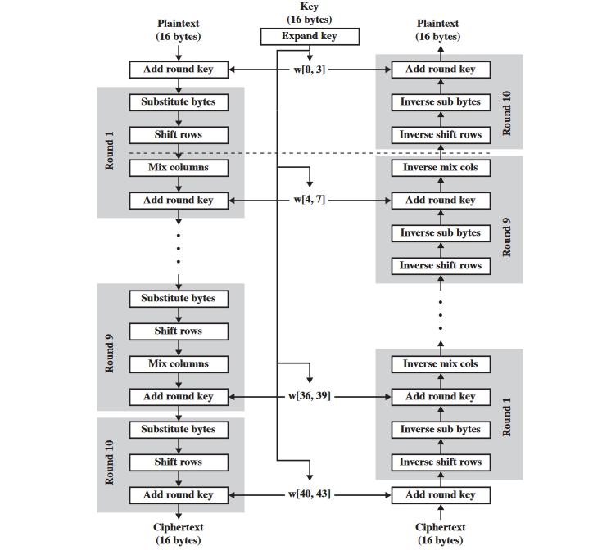
Fig:AES Encryption and Decryption

Slide 52
Four different stages are used, one of permutation and three of substitution:
• Substitute bytes: Uses an S-box to perform a byte-by-byte substitution of the block
• ShiftRows: A simple permutation
• MixColumns: A substitution that makes use of arithmetic over
• AddRoundKey: A simple bitwise XOR of the current block with a portion of the expanded key

Slide 53
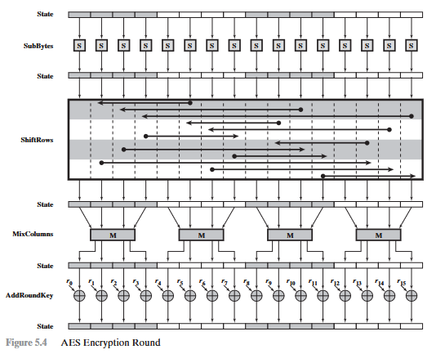

Slide 54
Blowfish
Blowfish was developed by Bruce Schneier, and has the reputation of being a very strong symmetric- key cryptographic algorithm. According to Schneier, Blowfish was designed with the following objec- tives in mind.
(a) Fast Blowfish encryption rate on 32-bit microprocessors is 26 clock cycles per byte.
(b) Compact Blowfish can execute in less than 5 KB memory.
(c) Simple Blowfish uses only primitive operations, such as addition, XOR and table look-up, mak-ing its design and implementation simple.
(d) Secure Blowfish has a variable key length up to a maximum of 448 bits long, making it both flexible and secure[min 32 bits to max 448 bits]

Slide 55
Operation
Blowfish encrypts 64-bit blocks with a variable-length key. It contains two parts, as follows.
(a) Subkey Generation This process converts the key up to 448 bits long to subkeys totaling 4168 bits.
(b) Data Encryption This process involves the iteration of a simple function 16 times. Each round contains a key-dependent permutation and key- and data-dependent substitution.

Slide 56
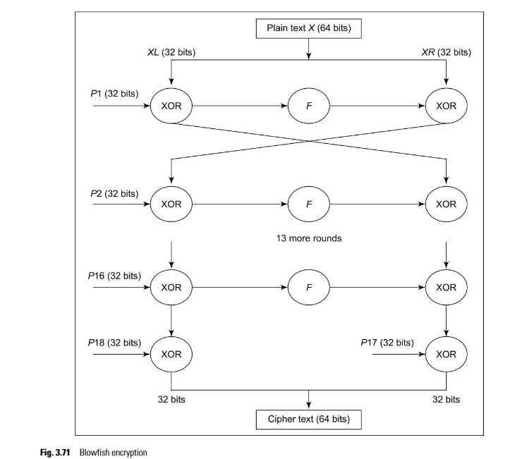

Slide 57
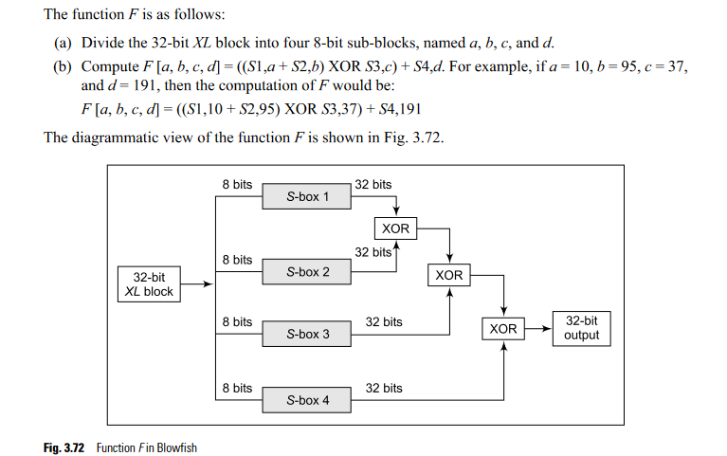

Slide 58
Symmetric algorithm
Caesar Cipher
monoalphabetic substitution cipher
Hill Cipher
Des
Triple des
Blowfish
aes

Slide 59
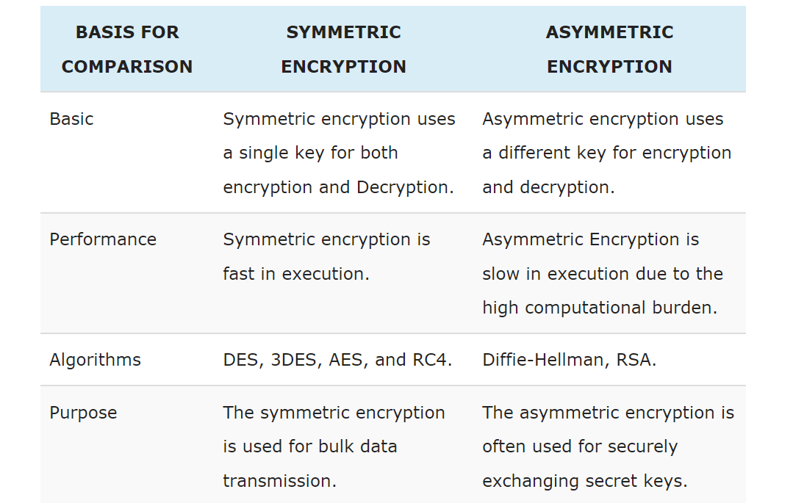

Slide 60
RC4
RC4 was designed by Ron Rivest of RSA Security in 1987. The official name for this algorithm is “Rivest Cipher 4”. However, because of its ease of reference, the acronym RC4 has stuck.
RC4 is a stream cipher. This means that the encryption happens byte-by-byte. However, this can be changed to bit-by-bit encryption (or to a size other than a byte/bit).
RC4 has become part of some widely used encryption techniques and standards, including WEP and WPA for wireless cards and TLS. What has made its wide deployment possible is its speed and sim- plicity of design. Implementations in both software and hardware are possible. RC4 does not consume many resources.

Slide 61
Description
RC4 generates a pseudorandom stream of bits called keystream. This is combined with the plain text using XOR for encryption. Even decryption is performed in a similar manner.
There is a variable length key consisting of 1 to 256 bytes (or 8 to 2048 bits). This key is used to initial-ize a 256-byte state vector with elements identified as S [0]. S [1]. ...., S [255]. To perform an encryption or decryption operation, one of these 256 bytes of S is selected, and processed. We will call the resulting output as k. After this, the entries in S are permuted once again. Overall, there are two processes involved: (a) initialization of S, and (b) stream generation. We describe these below

Slide 62
1. Initialization of S
This process consists of the following steps.
1. Choose a key (K) of length between 1 and 256 bytes.
2. Set the values in the state vector S equal to the values from 0 to 255 in an ascending order. In other words, we should have S [0] = 0, S [1] = 1, …, S [255] = 255.
3. Create another temporary array T. If the length of the key K (termed as keylen) is 256 bytes, copy K into T as is. Otherwise, after copying K to T, whatever are the remaining positions in T are filled with the values of K again. At the end, T should be completely filled

Slide 63
Thus, the following steps are executed:
for i = 0 to 255
// Copy the current value of i into the current position in the S array
S [i] = i;
// Now copy the contents of the current position of the K array into T. If K is exhausted, loop back
// to get the values of the K array from the unexhausted portion of K.
T [i] = K [i mod keylen];
A small Java program shown in Fig. 3.53 implements this logic. Here, we have considered that the K array contains 10 elements, i.e. keylen is 10.

Slide 64
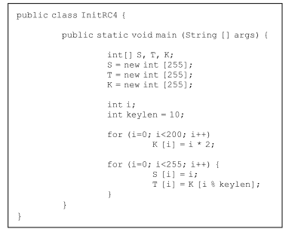

Slide 65
2. Stream Generation
Now that the S array is ready with the above initializations and permutations, the initial key array K is discarded. Now, we need to again loop for i = 0 to 255. In each step, we swap S [i] with another byte in S, as per the mechanism decided by the implementation of S. Once we exhaust the 255 positions, we need to restart at S [0].
The logic is as follows:
i = 0;
j = 0;
while (true)
i = (i + 1) mod 256;
j = (j + S [i]) mod 256;
swap (S [i], S [j]);
t = (S [i] + S [j]) mod 256;
k = S [t];
After this, for encryption, k is XORed with the next byte of the plain text. For decryption, k is XORed
with the next byte of the cipher text.

Slide 66
Asymmetric encryption
Asymmetric encryption is a form of cryptosystem in which encryption and decryption are performed using the different keys—one a public key and one a private key.It is also known as public-key encryption.
◆ Asymmetric encryption transforms plaintext into ciphertext using a one of two keys and an encryption algorithm.Using the paired key and a decryption algorithm,the plaintext is recovered from the ciphertext.
◆ Asymmetric encryption can be used for confidentiality, authentication, or both.

Slide 67
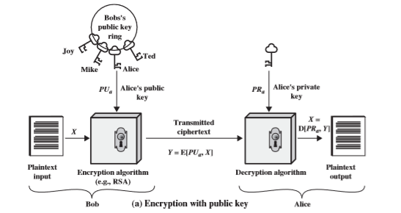
PRINCIPLES OF PUBLIC-KEY CRYPTOSYSTEMS

Slide 68
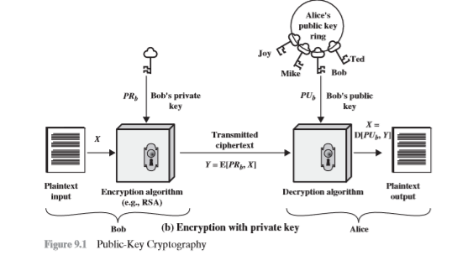

Slide 69
A public-key encryption scheme has six ingredients
Plaintext: This is the readable message or data that is fed into the algorithm as input. Encryption algorithm: The encryption algorithm performs various transformations on the plaintext.Public and private keys: This is a pair of keys that have been selected so that if one is used for encryption, the other is used for decryption. The exact transformations performed by the algorithm depend on the public or private key that is provided as input.
• Ciphertext: This is the scrambled message produced as output. It depends on the plaintext and the key. For a given message, two different keys will produce two different ciphertexts. Decryption algorithm: This algorithm accepts the ciphertext and the matching key and produces the original plaintext.

Slide 70
The essential steps are the following.
1. Each user generates a pair of keys to be used for the encryption and decryption of messages.
2. Each user places one of the two keys in a public register or other accessible file.
3. If Bob wishes to send a confidential message to Alice,Bob encrypts the message using Alice’s public key.
4. When Alice receives the message, she decrypts it using her private key. No other recipient can decrypt the message because only Alice knows Alice’s private key.

Slide 71
RSA(Rivest-Shamir-Adleman)
The most widely used public-key cryptosystem is RSA. The difficulty of attacking RSA is based on the difficulty of finding the prime factors of a composite number.

Slide 72
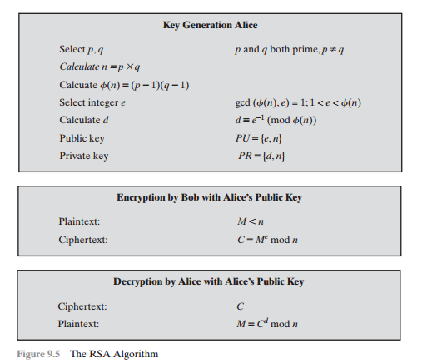
RSA

Slide 73
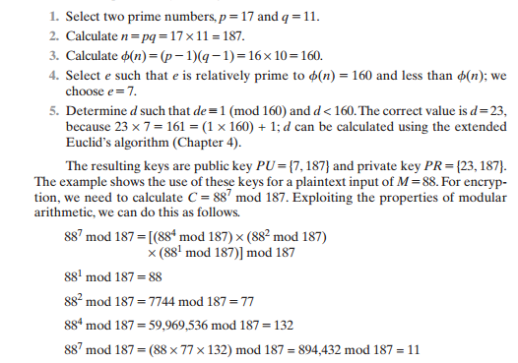

Slide 74
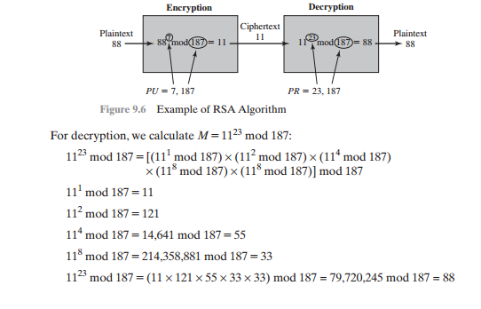

Slide 75
The Security of RSA Four possible approaches to attacking the RSA algorithm are
Brute force: This involves trying all possible private keys.
Mathematical attacks: There are several approaches, all equivalent in effort to factoring the product of two primes.
Timing attacks: These depend on the running time of the decryption algorithm.
Chosen cipher text attacks: This type of attack exploits properties of the RSA algorithm.

Slide 76
Diffie-Hellman key exchange
A simple public-key algorithm is Diffie-Hellman key exchange. This pro- tocol enables two users to establish a secret key using a public-key scheme based on discrete logarithms. The protocol is secure only if the authenticity of the two participants can be established.
The purpose of the algorithm is to enable two users to securely exchange a key that can then be used for subsequent encryption of messages. The algorithm itself is limited to the exchange of secret values.

Slide 77
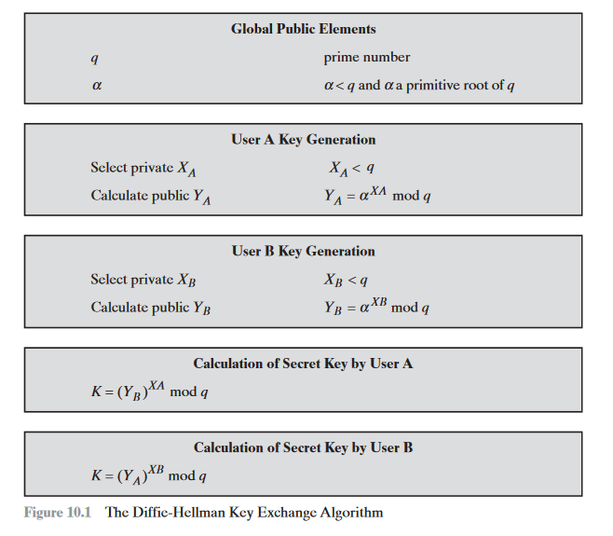

Slide 78
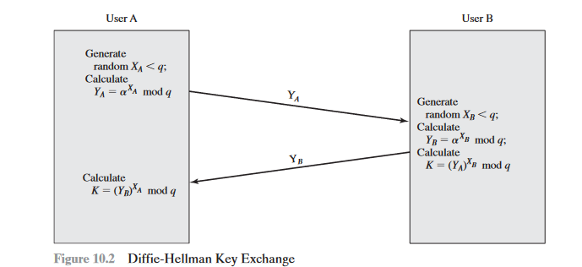
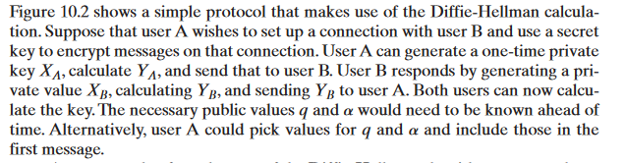
Key Exchange Protocols

Slide 79
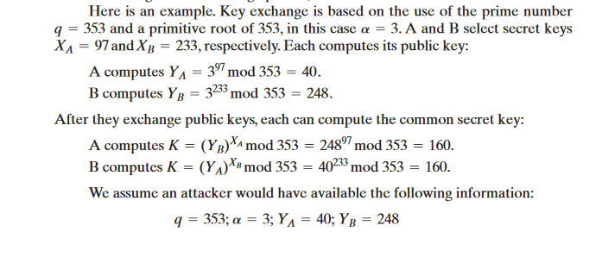

Slide 80
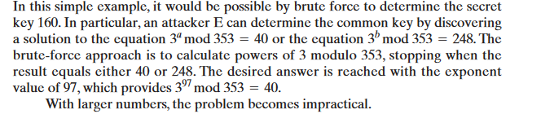

Slide 81
ElGamal cryptographic system
Elgamal announced a public-key scheme based on discrete logarithms, closely related to the Diffie-Hellman technique.
The ElGamal cryptosystem is used in some form in a number of standards including the digital signature standard (DSS), S/MIME e-mail standard

Slide 82
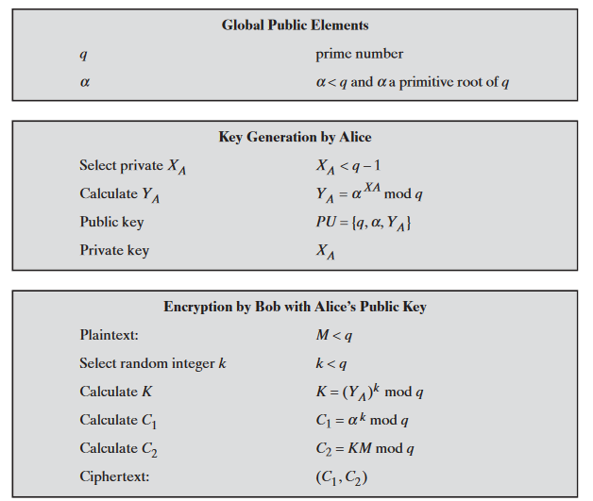

Slide 83
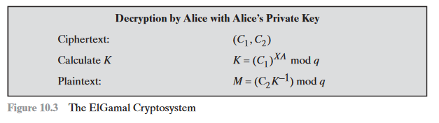
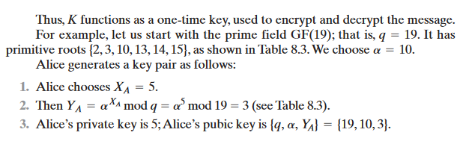

Slide 84


